Slide 1

EagleSat II: Developing and Integrating Satellite Communications Systems
Joshua Parmenter and Hayden Roszell
NASA Space Grant Symposium || Tucson, Arizona || 23 Apr 2022

Slide 2
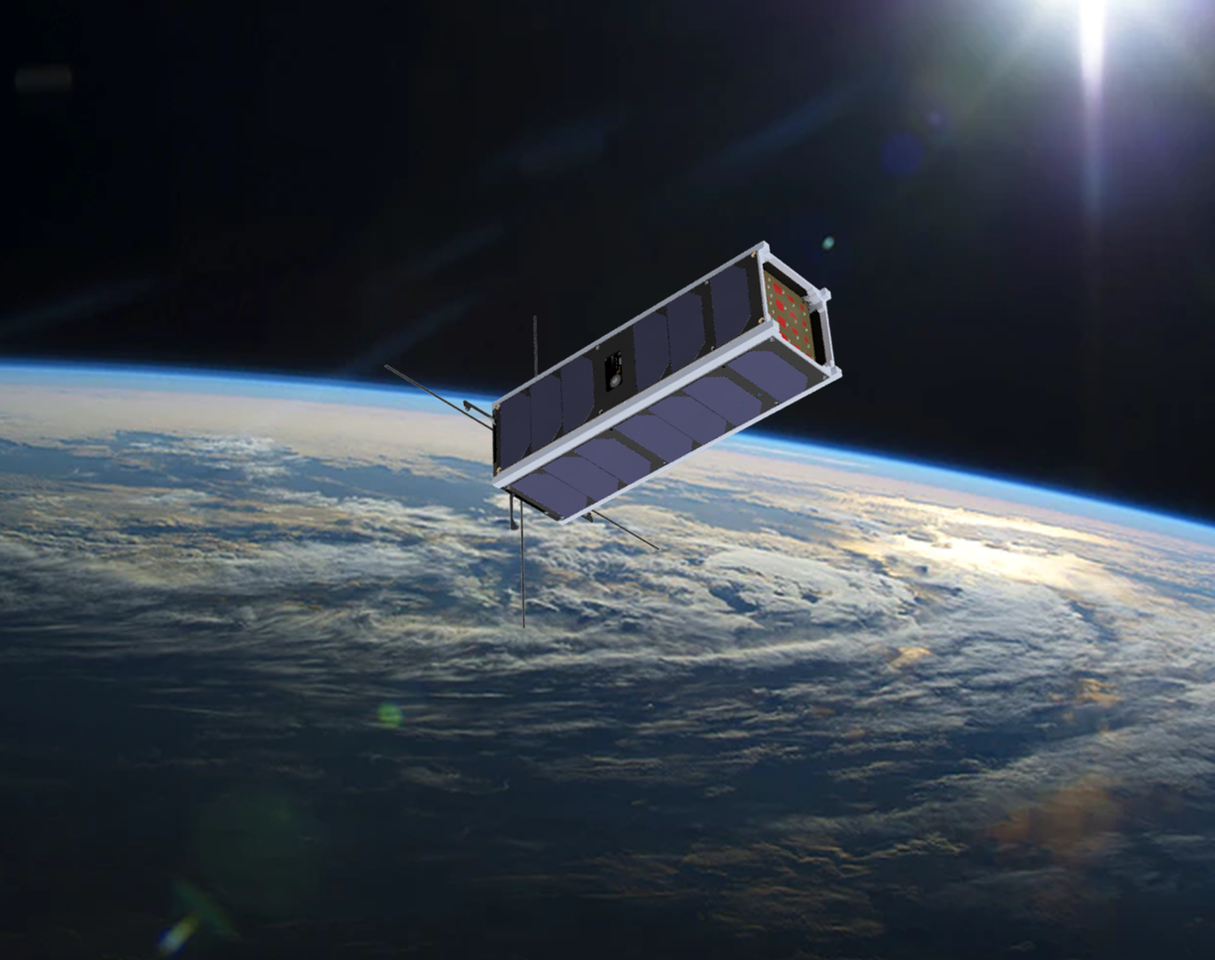


Overview
Introduction
Acknowledgements
Research Question
Objectives
Iterations
Challenges
Current State/Looking Forward

Slide 3
Introduction & Acknowledgements
Joshua Parmenter – Engineering team lead
Hayden Roszell – Engineering team lead
EagleSat II - Undergraduate student organization
Thank you to
NASA Space Grant
Undergraduate Research Institution - Dr. Boettcher
Our mentor, Dr. Ahmed Sulyman
Embry-Riddle Aeronautical University

Slide 4
Overarching Question and Goals
Can undergraduate students design and build an efficient communications infrastructure for a CubeSat?
Objectives​ (of our teams)
Maintain reliable command and control with the satellite​
Autonomously manage satellite operations with a space-grade microprocessor​
Collect and store scientific research data

Slide 5
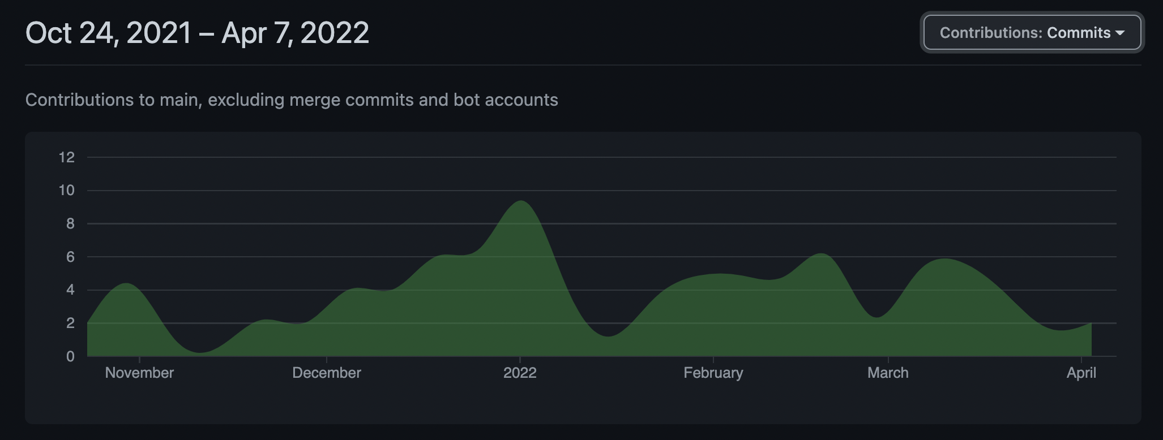
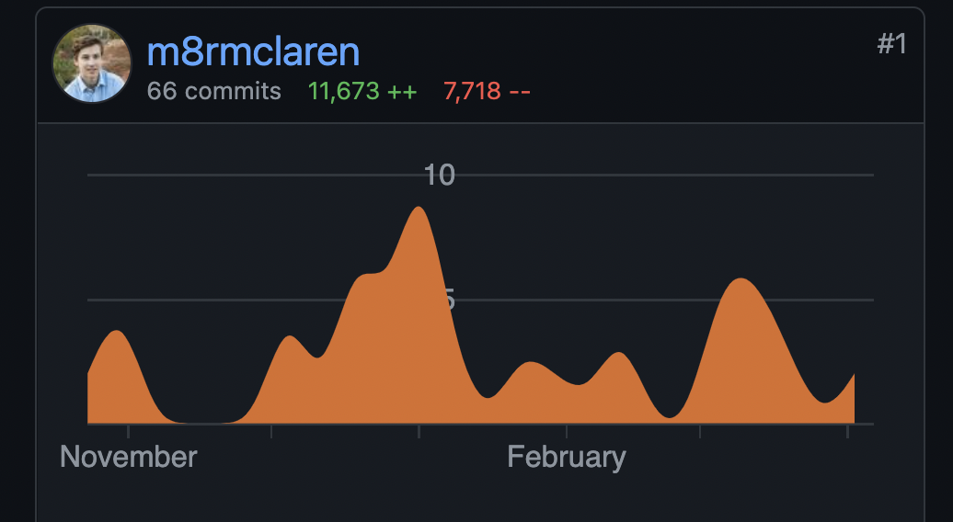
Our most important lesson: “Fail Fast”
If a design “doesn’t seem quite right,” don’t ignore that feeling!
Started with full-stack communications design
In 6 months, this is nowhere near the current design
Notes:
Don’t look at how much code I wrote, look at how much code I deleted.

Slide 6
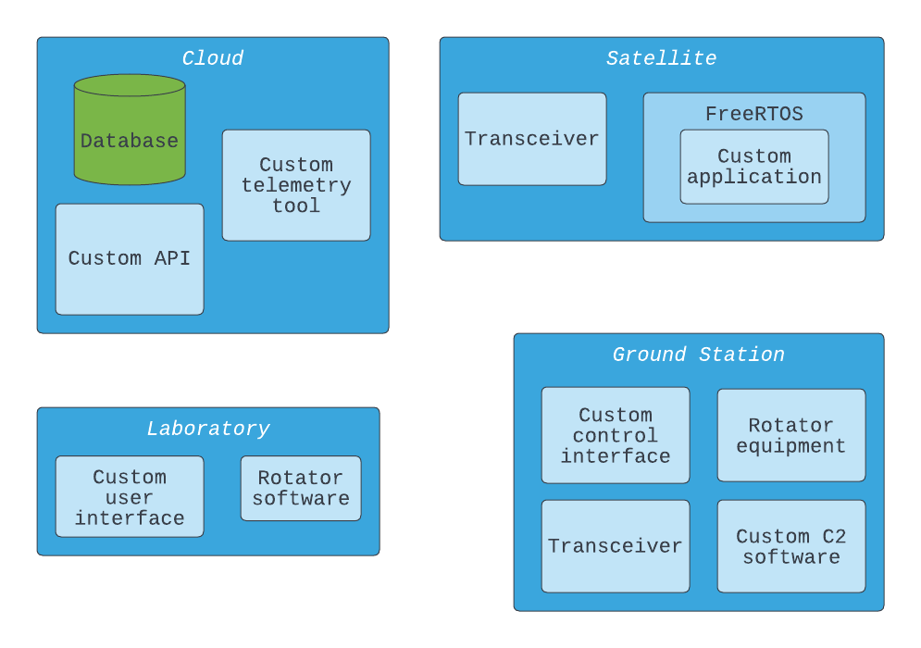

Slide 7
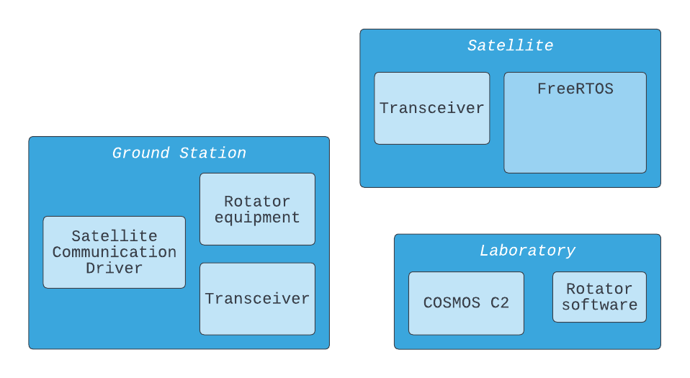
Simplified down to two primary components on the ground
Also using software and protocols native to OBC

Slide 8
Iterations of the Communication Protocol
Request-Response Protocol (Client-Server model)
Command/Telemetry data streams
Request-Response with connection/connectionless modes

Slide 9
Iterations of the Communication Medium
AX.25 UI frames with custom data field structure (command and beacon)
AX.25 protocol (command and beacon)
Proprietary protocol supported by OBC SDK (command) and AX.25 UI (beacon)

Slide 10

It has to be asked: Why not CCSDS?
Not supported by our transceivers
Packet structure is too heavy

Slide 11
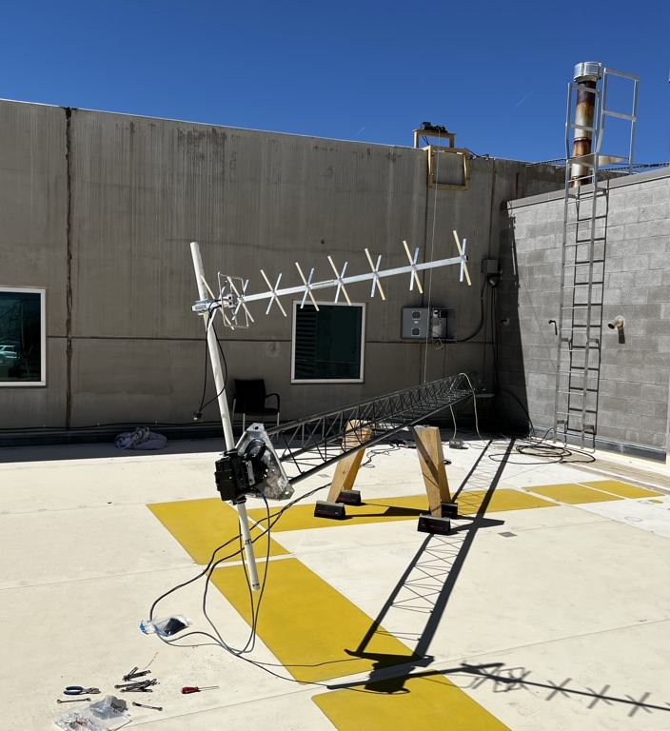
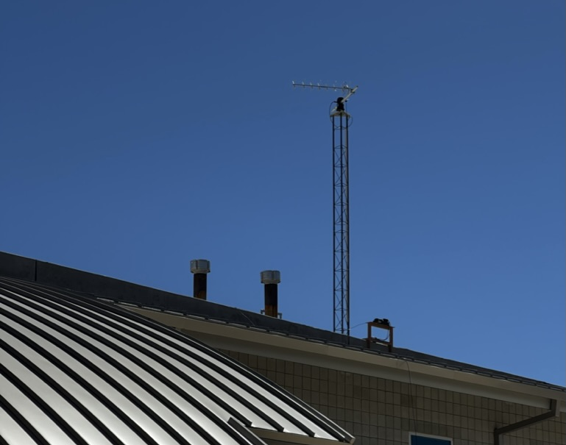
Ground Station
Headless ground station
Controlled remotely by primary ground station computer

Slide 12
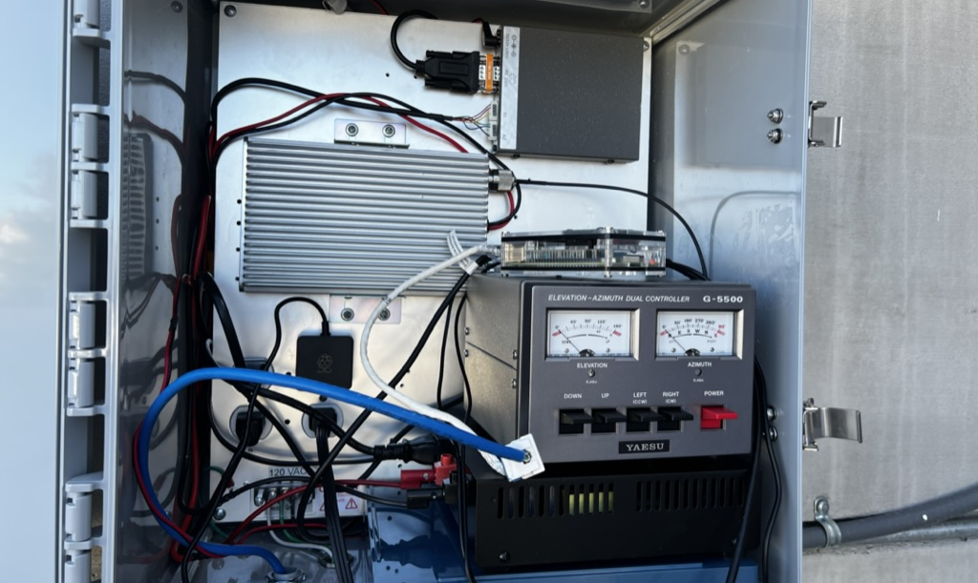
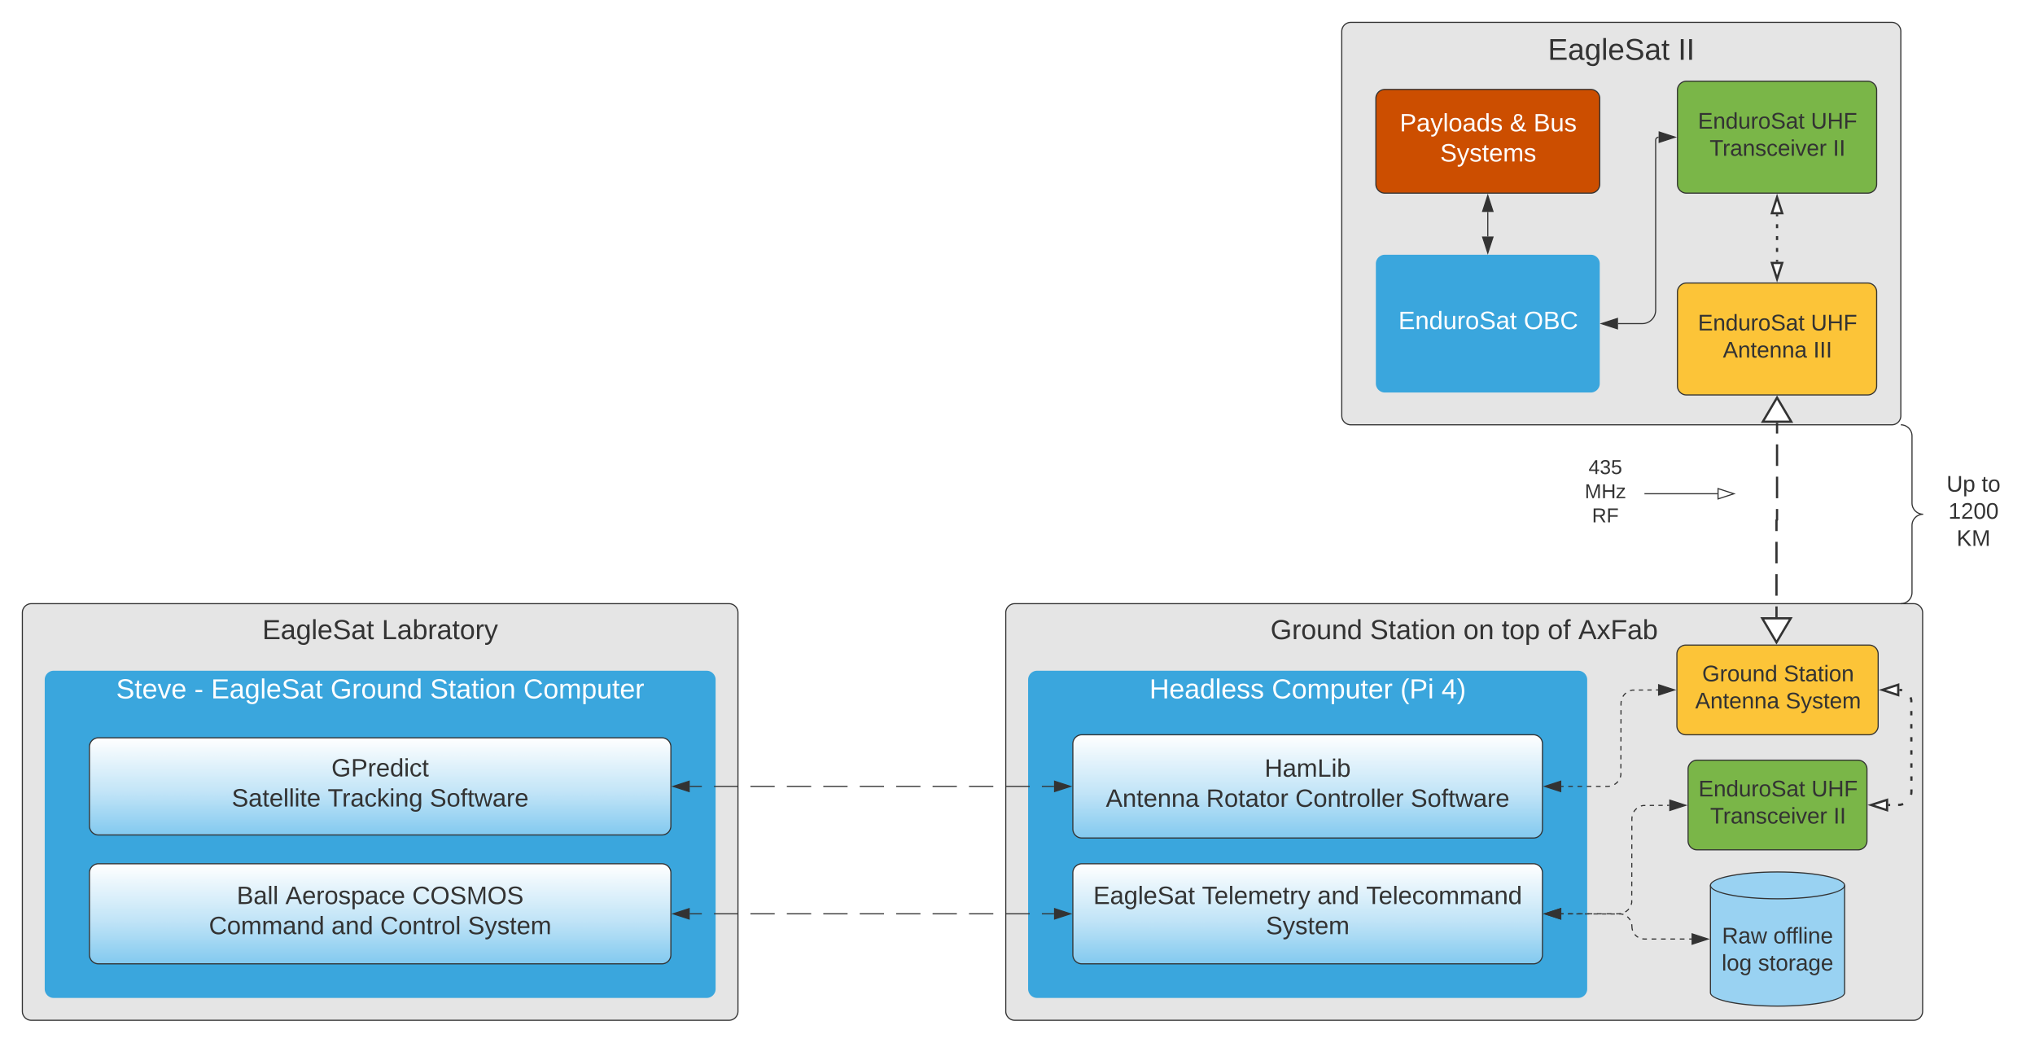

Slide 13
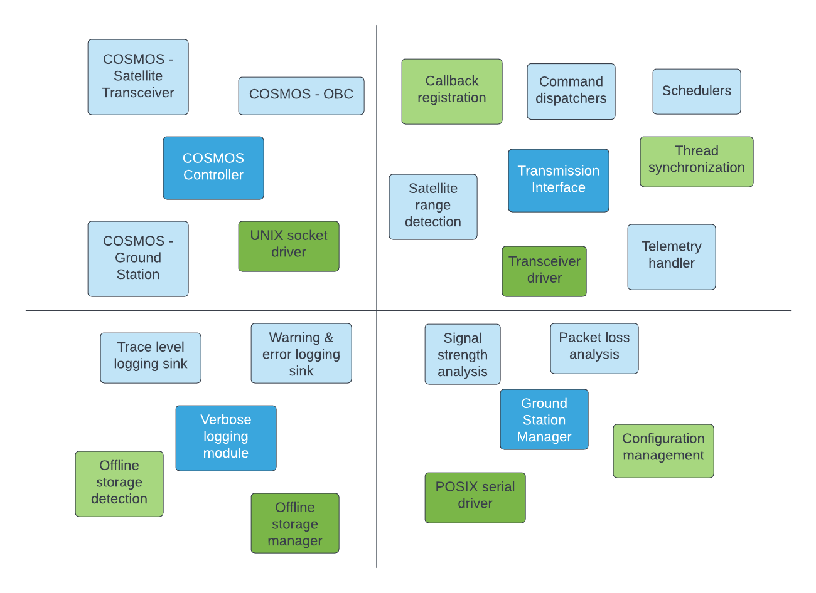
Satellite Communication Driver

Slide 14
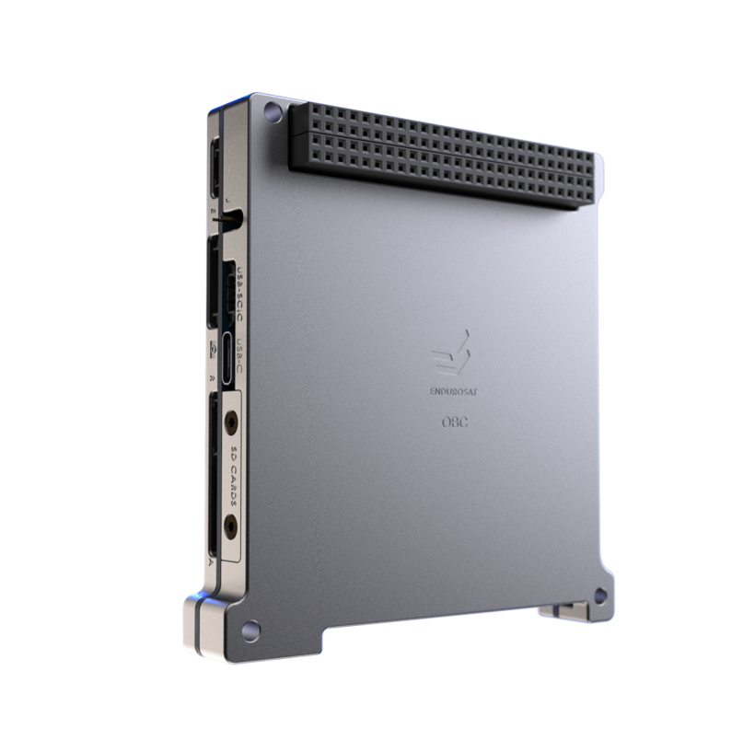
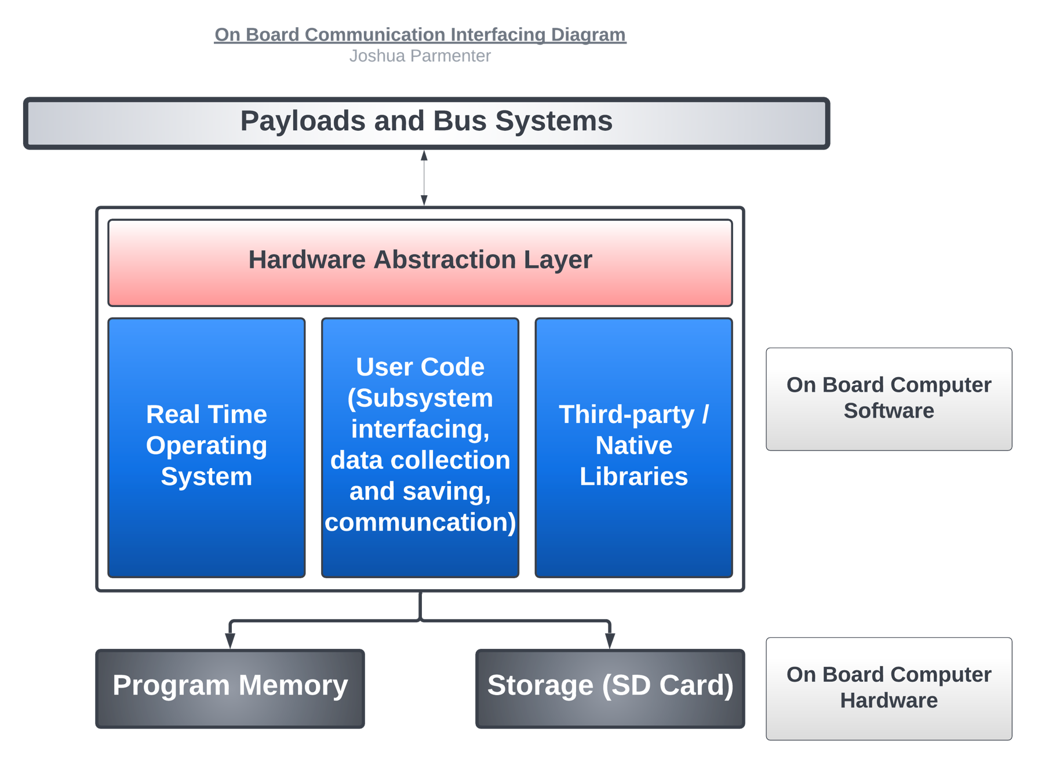
On Board Computer Communications Infrastructure
Real time operating system, keeps satellite alive.
Orchestrates subsystem communication and telemetry collection
Integrates session handling with the ground station
EnduroSat On Board Computer

Slide 15
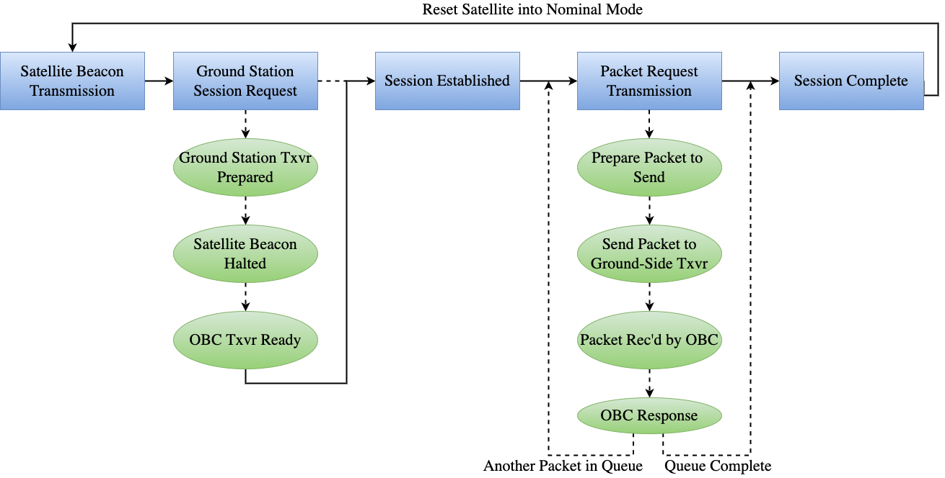
Satellite Communication Flow Diagram

Slide 16
Code Extensibility
Efficient infrastructure changes require extensible code
Develop solutions that aren’t ‘hacky’
Standardized interfaces
Polymorphism
Reduce parallelism (tricky but possible)
Don’t Repeat Yourself
Simplified and abstracted
Reduce repetition

Slide 17
Working with Undergraduates
We are busy, unpaid, and unexperienced.
How do we maximize productivity?
Strategies employed:
Weekly coding sessions
Enables easy teamwork
Bi-weekly sprint planning
Convenient communication (discord)
Developing connections with the team, plant intrinsic motivators
Make them understand the magnitude of their work!

Slide 18
Next Steps
Test ground station with similar satellites in orbit.
Polish OBC/Ground Station Communication.
OBC subsystem integration
Test, test, test...
Edge Case Testing
Long Term Testing

Slide 19
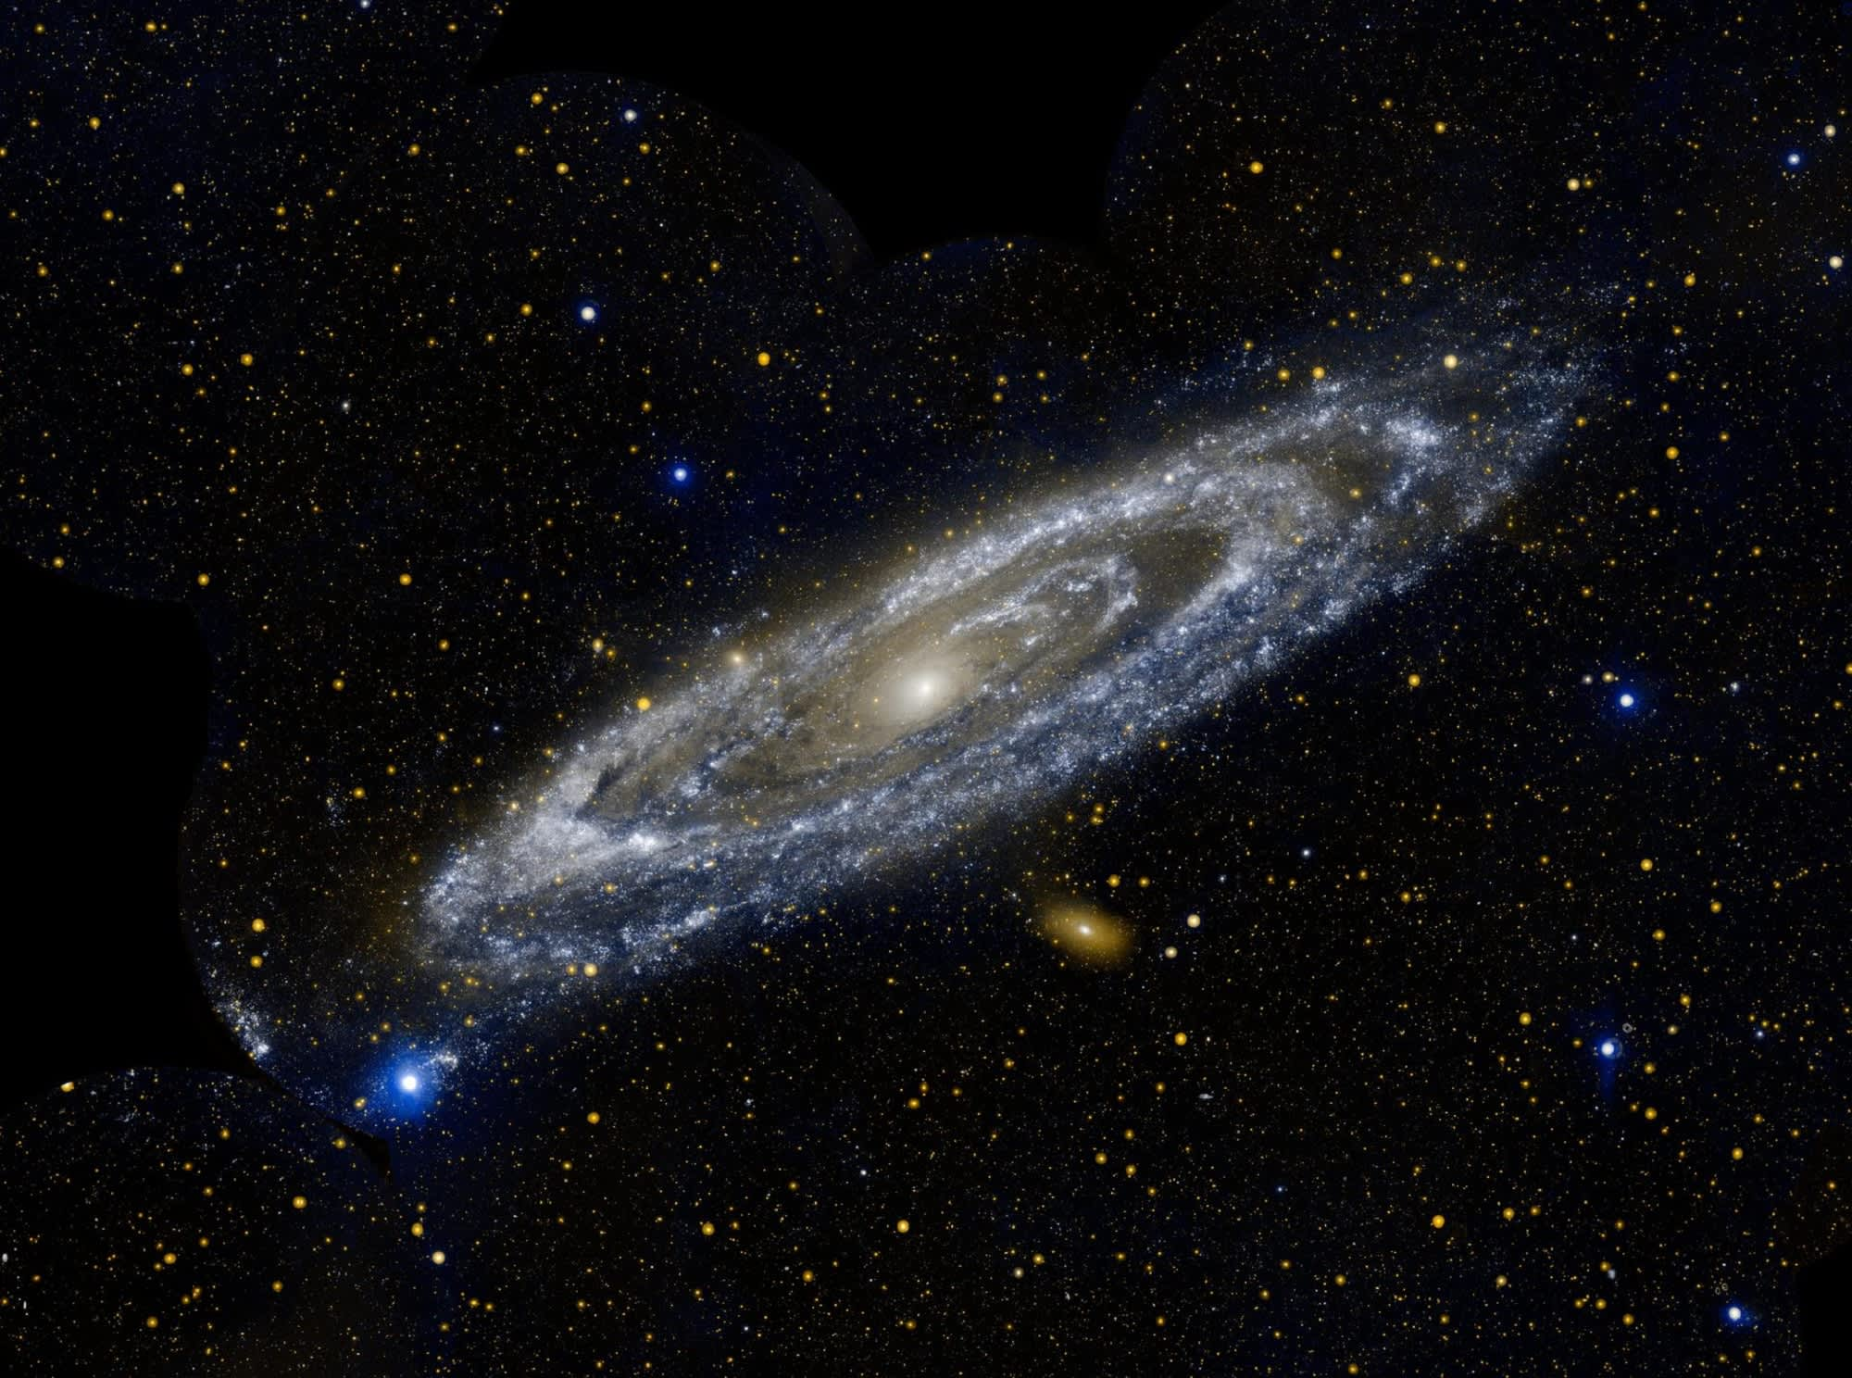
Conclusion
Launching an effective satellite as an undergraduate is not impossible.
Iterative designs are key
"Fail Fast"
Notes:
Make comment on how this applies for any large project with limited mentorship or documentation.

